Slide 1

Characterizing the Complexity of Fibrillation from Models and Experiments with Lyapunov Exponents
Will AN
Mikael Toye, Dr. Abouzar Kaboudian, Prof. Flavio H. Fenton
Georgia Tech School of Physics

Slide 2
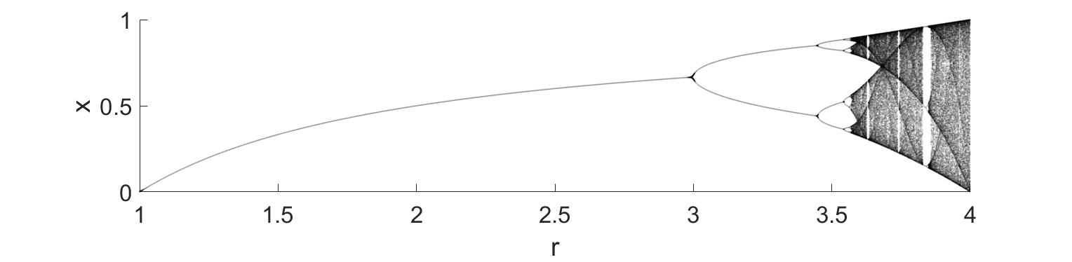
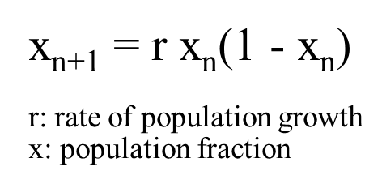
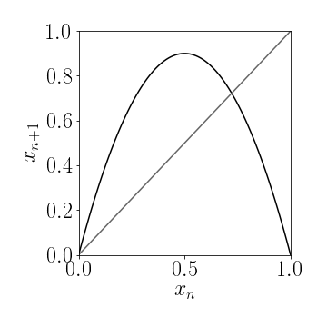

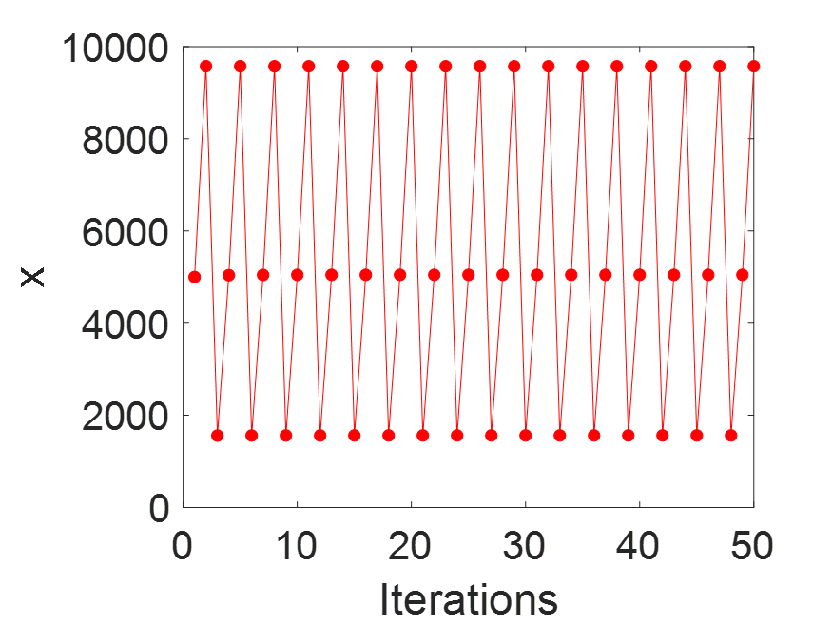
Some brief introduction to Chaos
Chaos in 1-D Logistic Map
r=2.6
r=3.3
r=3.9

Slide 3
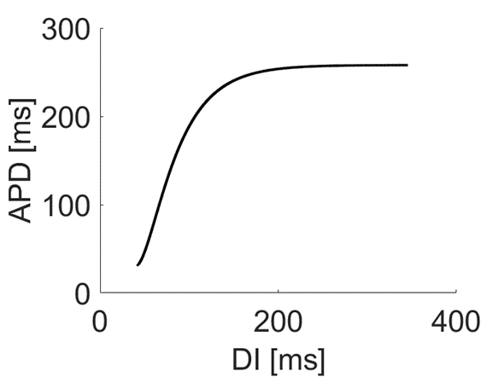
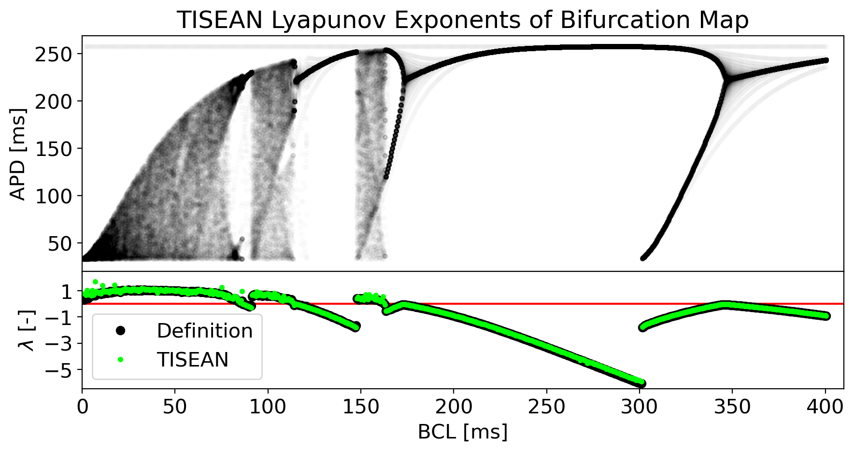
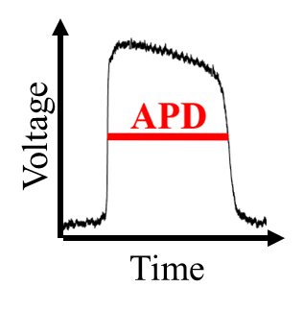
Showing chaos in cardiac map model
Beeler-Reuter cardiac model
Restitution map:
APD Restitution Curve
(Basic Cycle Length / Pacing Period)

Slide 4
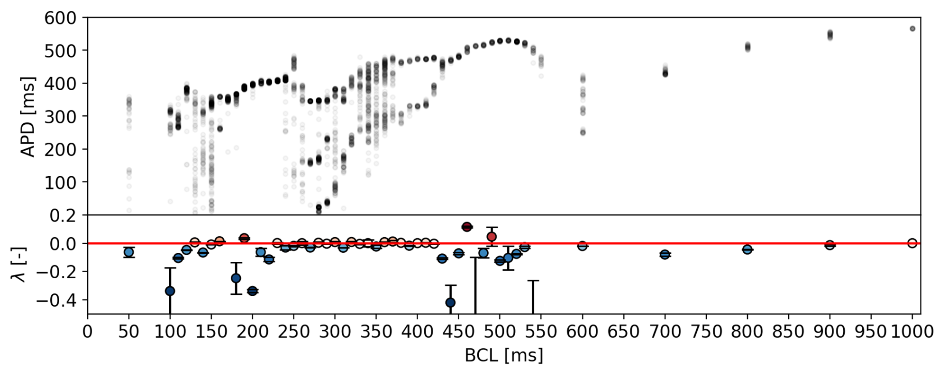
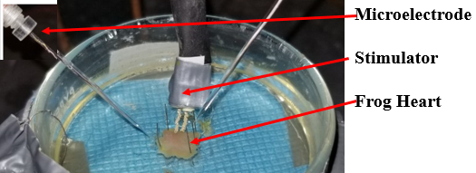
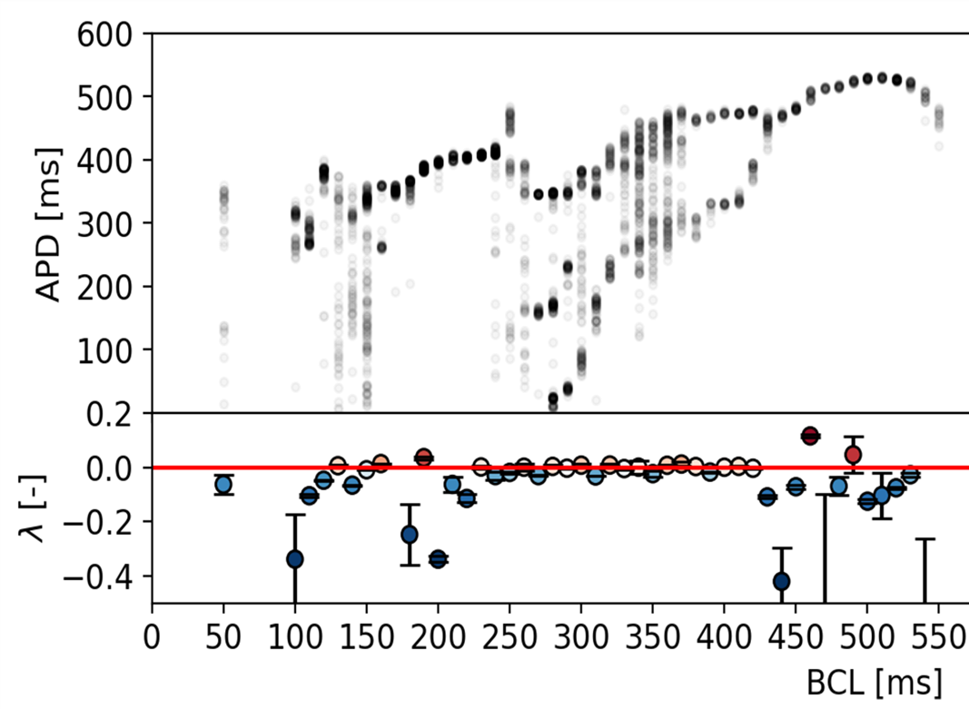
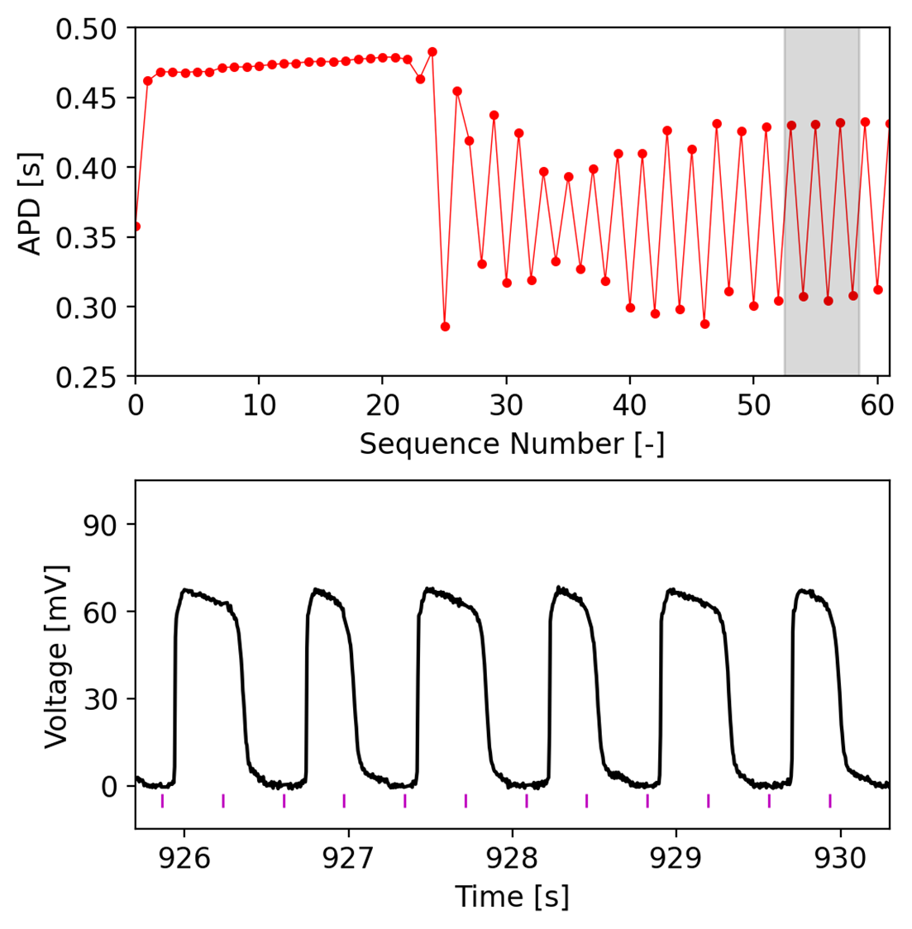
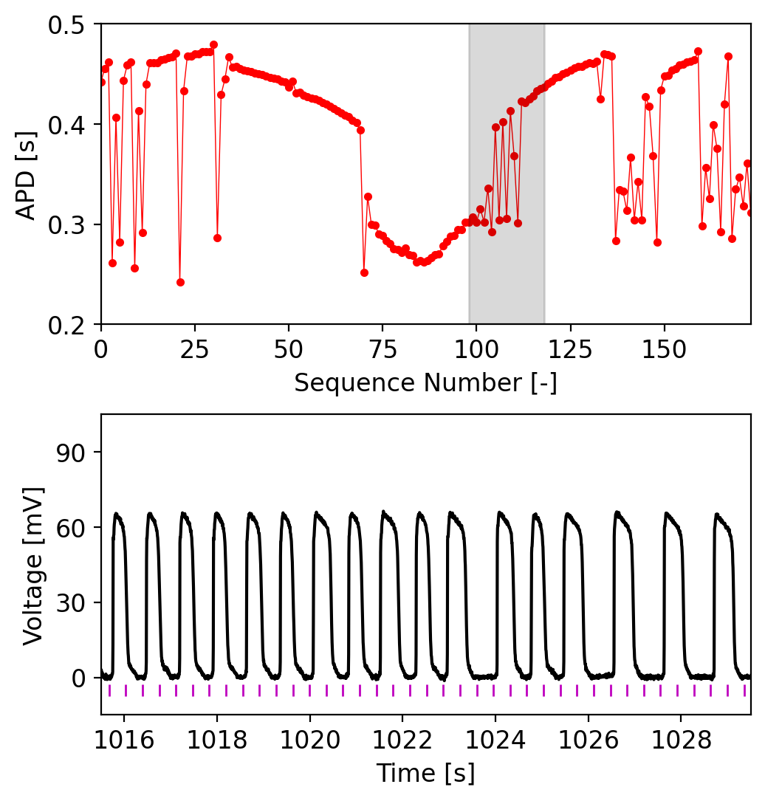
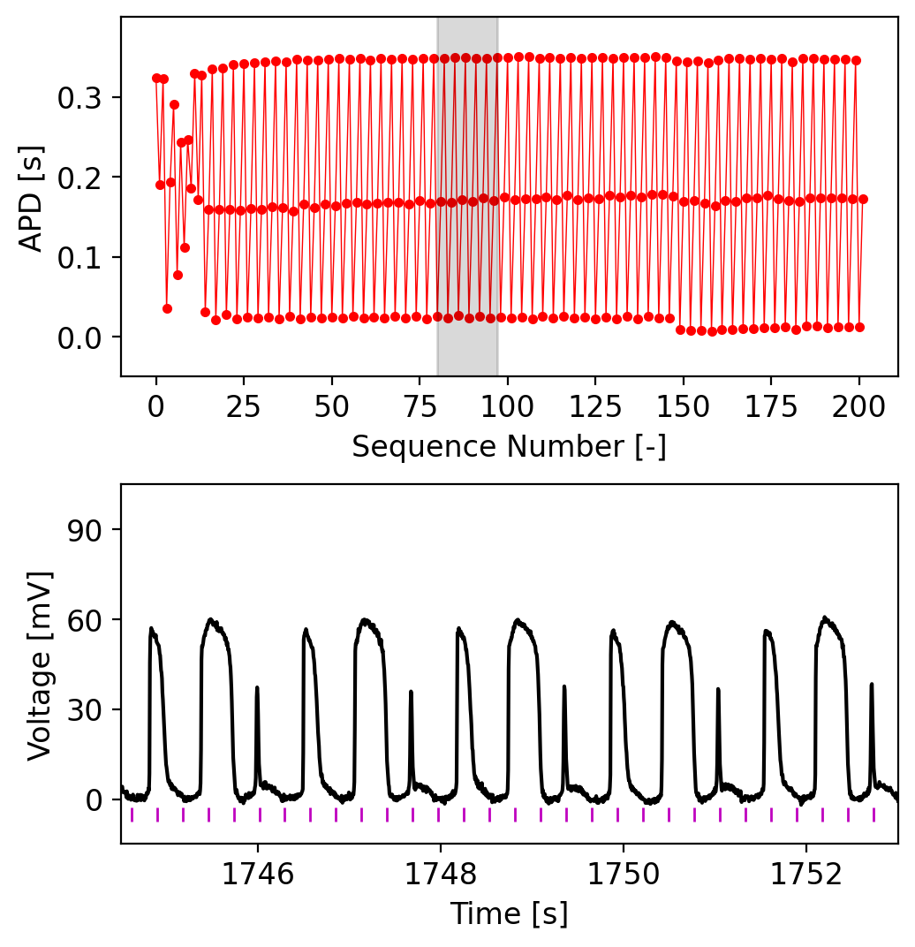
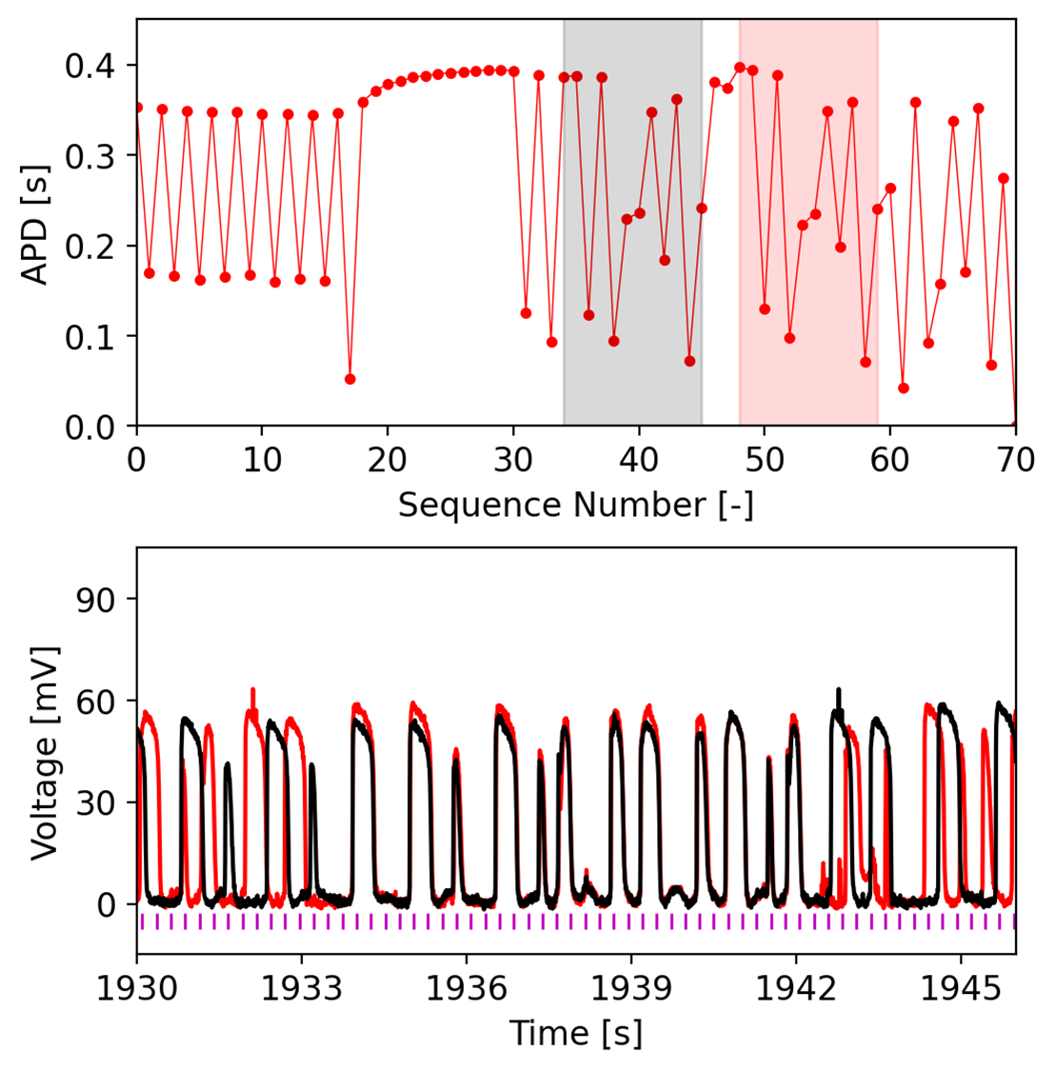
Showing chaos in experimental data
Frog heart experiment
B
D
C
A
BCL [ms]
A) BCL 370 ms: Period 2
B) BCL 360 ms
C) BCL 280 ms: Period 3
D) BCL 260 ms

Slide 5
Just like in the logistic map, it is possible to obtain a bifurcation diagram from fast pacing in cardiac tissue
How can we characterize the amount of complexity “chaos” from temporal and spatiotemporal data obtained in
numerical models and in experimental data?

Slide 6
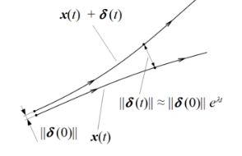
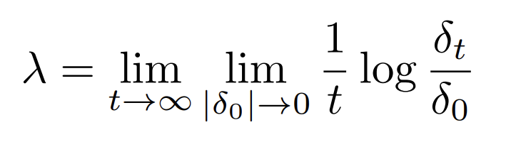
Quantify fibrillation in the heart: Lyapunov exponent
Lyapunov exponent of a dynamical system is to characterizes the rate of separation of infinitesimally close trajectories.
Formula for LE
λ > 0: chaotic system
δ(t)>>δ(0) (difference has exp growth)
λ = 0: periodic
δ(t)=δ(0) (difference has no growth)
λ < 0: stable (convergence)
Usually, we use the maximal Lyapunov exponent (MLE)
Which is the maximum possible LE you could get during iterations.
This means chaos

Slide 7
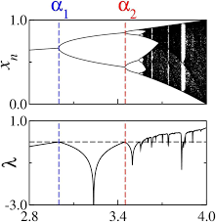
Quantify fibrillation in the heart: Lyapunov exponent
It is relatively easy to calculate the Lyapunov exponent from mathematical equations
But not from time series (simulations or experimental)
for this we will use TISEAN software
Logistic map
Beeler-Reuter cardiac map

Slide 8
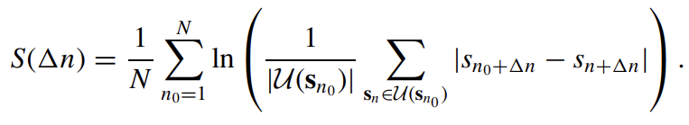
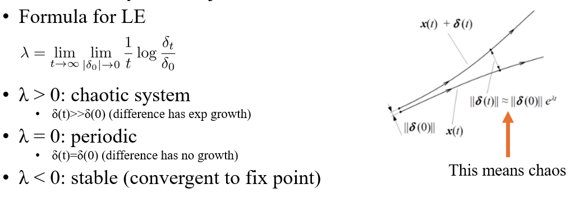
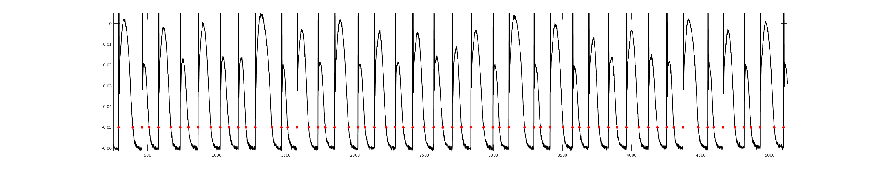
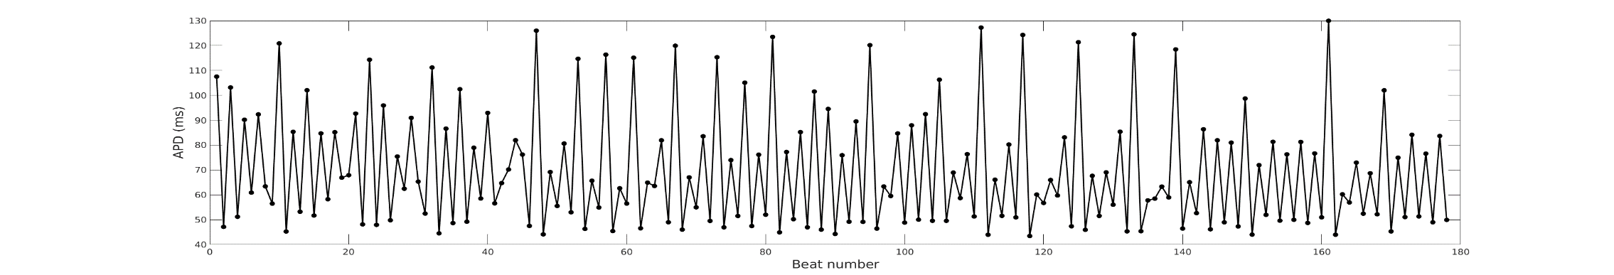
Temporal Method
: Nonlinear Time Series Analysis (TISEAN).
Basically, TISEAN will do self correlation analysis inside the temporal data series by picking similar data points and see how they diverge from each other.
For example, the two data points in circle are similar, and TISEAN will calculate their evolution after some beat numbers.
Then according to the definition, if any exponential growth, we can find the Lyapunov exponent.
The slope of the robust linear region during evolution will be considered as Lyapunov Exponent.
Hegger, R., Kantz, H., & Schreiber, T. (1999). Practical implementation of nonlinear time series methods:
The TISEAN package. Chaos (Woodbury, N.Y.), 9(2), 413–435. https://doi.org/10.1063/1.166424

Slide 9
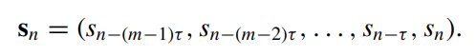
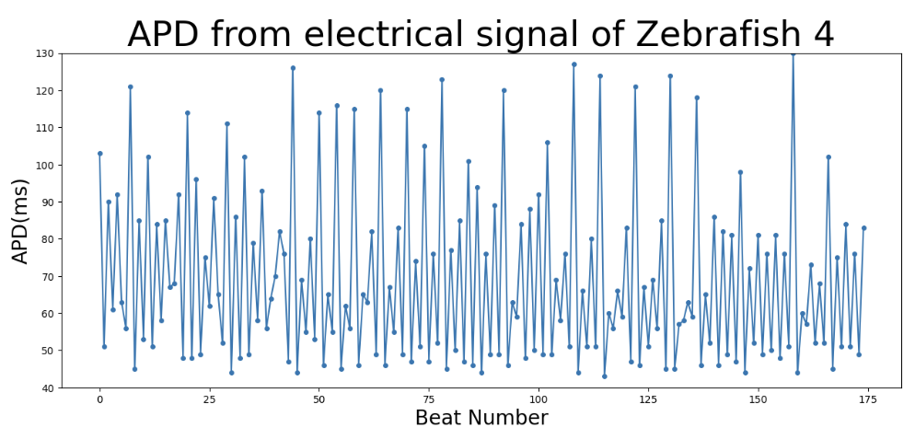
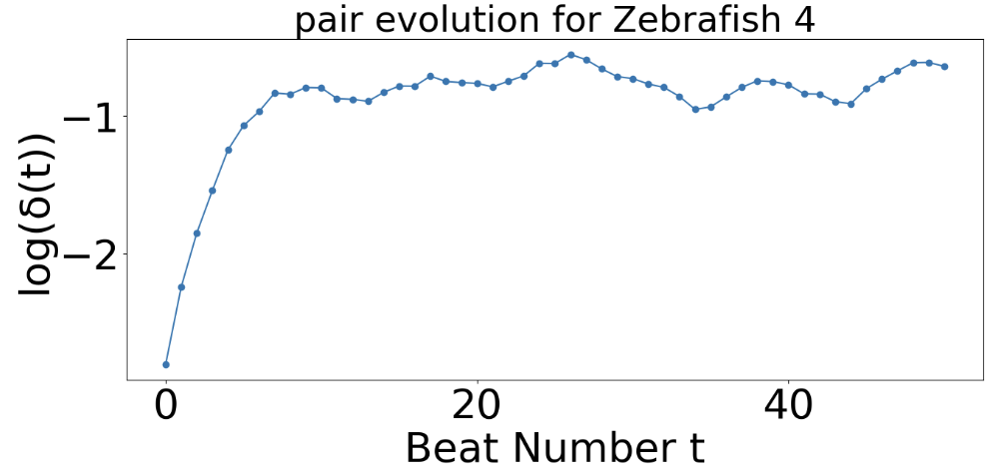
Temporal Method
m = 4, τ = 1, ε = 70
: Nonlinear Time Series Analysis (TISEAN).
Basically, TISEAN will do self correlation analysis inside the temporal data series by picking similar data points and see how they diverge from each other.
For example, the two data points in circle are similar (euclidian distance < ε), and TISEAN will calculate their evolution after some beat numbers.
Then according to the definition, if any exponential growth, we can find the Lyapunov exponent.
The slope of the robust linear region during evolution will be considered as Lyapunov Exponent.
APD signals from zebra fish heart experiment
Hegger, R., Kantz, H., & Schreiber, T. (1999). Practical implementation of nonlinear time series methods:
The TISEAN package. Chaos (Woodbury, N.Y.), 9(2), 413–435. https://doi.org/10.1063/1.166424

Slide 10
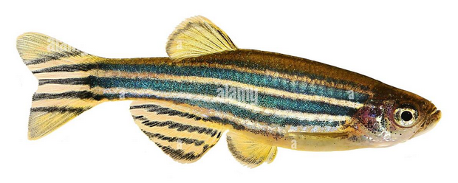
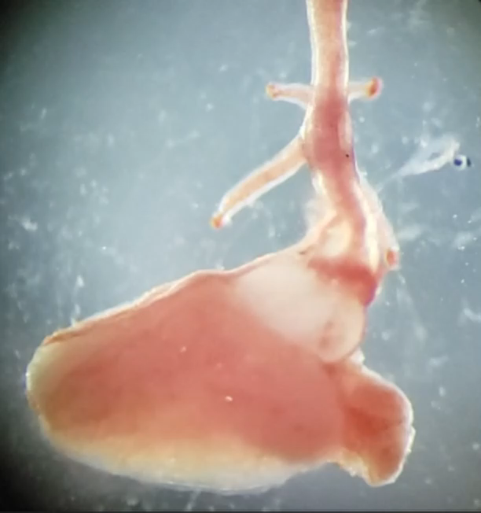
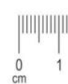
Quantify fibrillation in the heart: Lyapunov exponent
Example: Zebra fish heart experiment

Slide 11
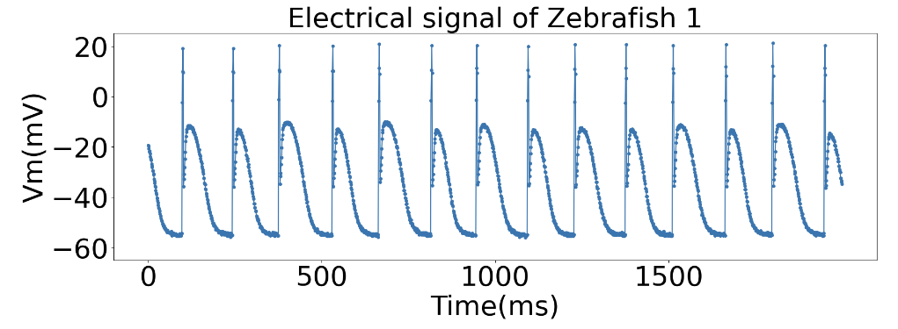
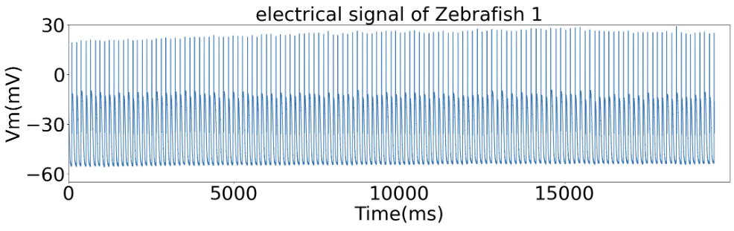
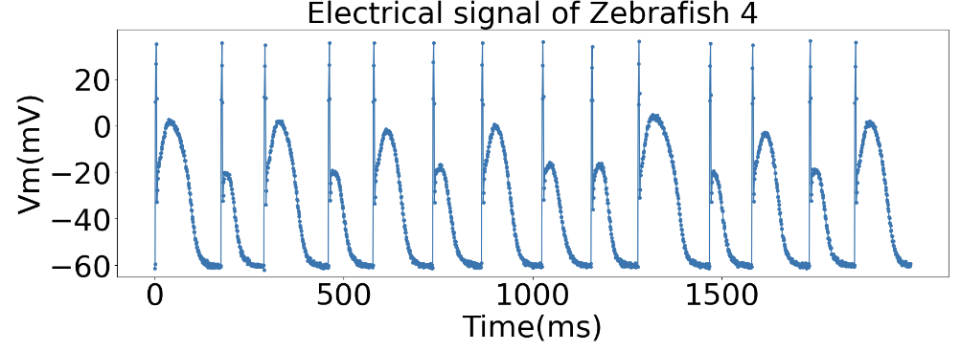
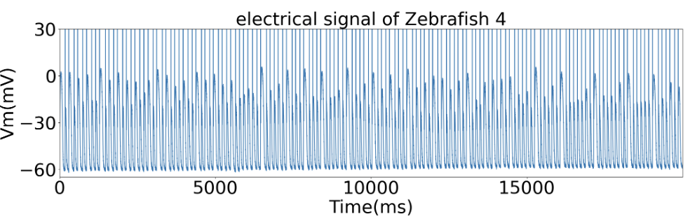
Quantify fibrillation in the heart: Lyapunov exponent
Example: Zebra fish heart experiment
Two experimental examples, one more irregular than the other

Slide 12
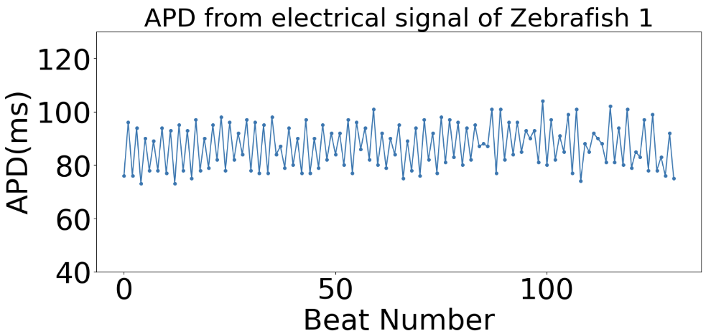
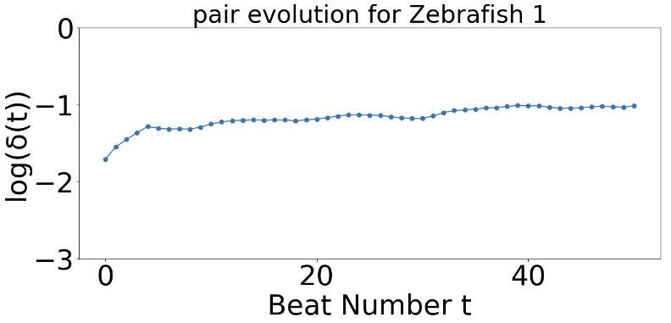
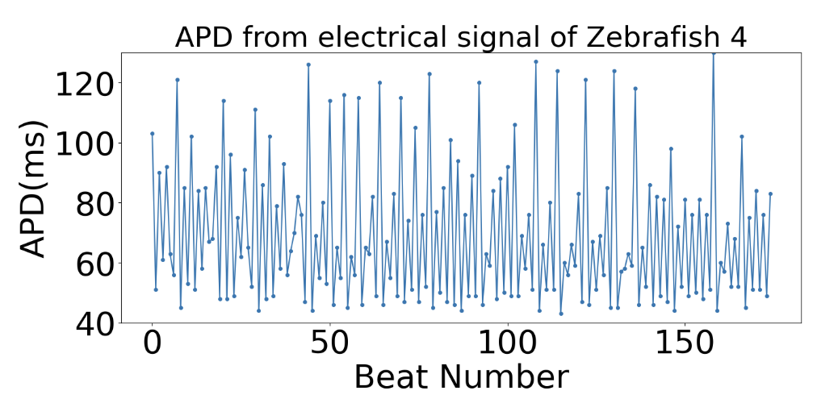
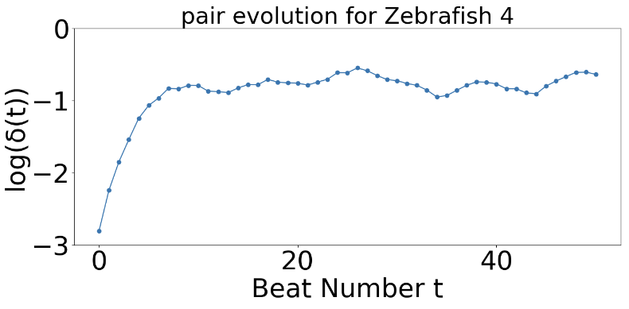
Quantify fibrillation: Temporal Method
Now, let’s see what we get for Zebrafish heart experiments (m = 4, ε = 70):
Experiments 1 and 2
Experiment 1
Lyp exp: 0.06
Experiment 2
Lyp exp: 0.30

Slide 13
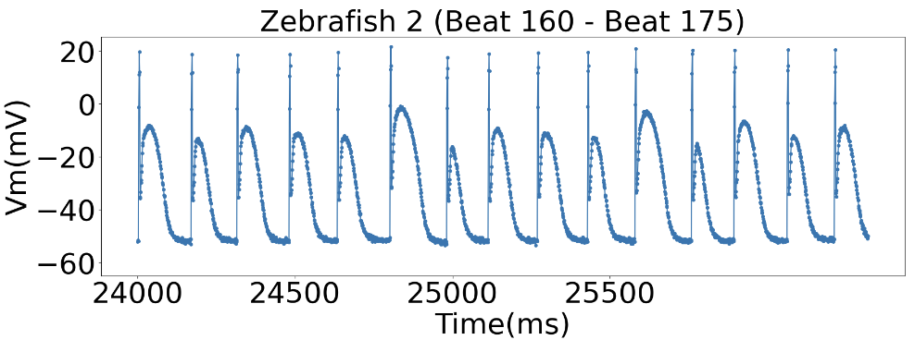
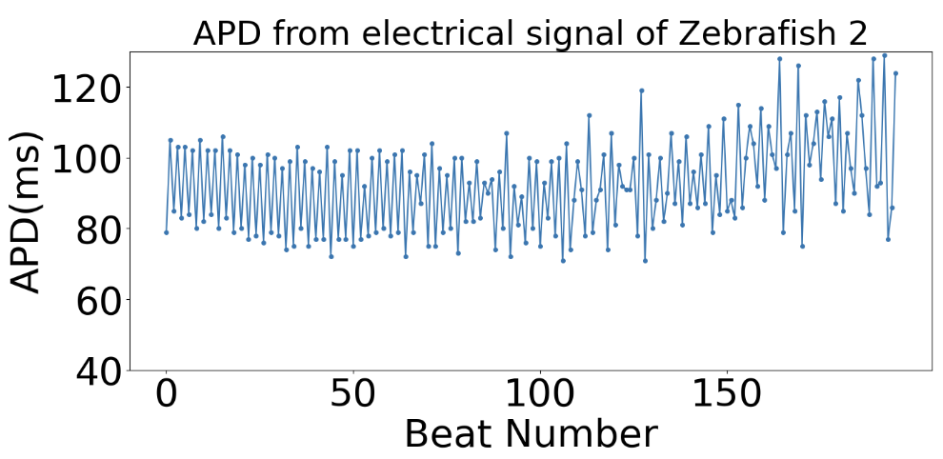
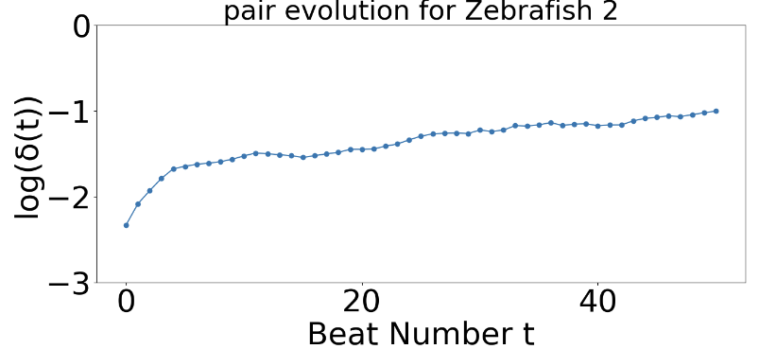
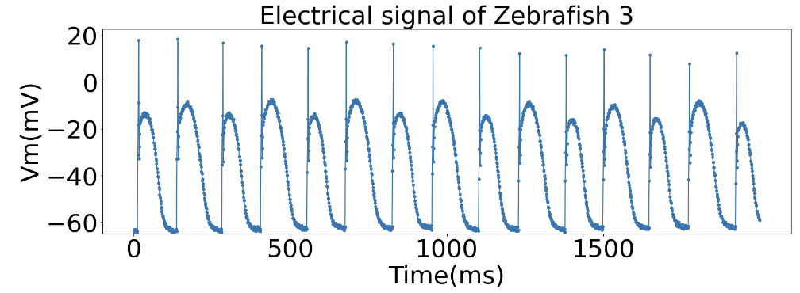
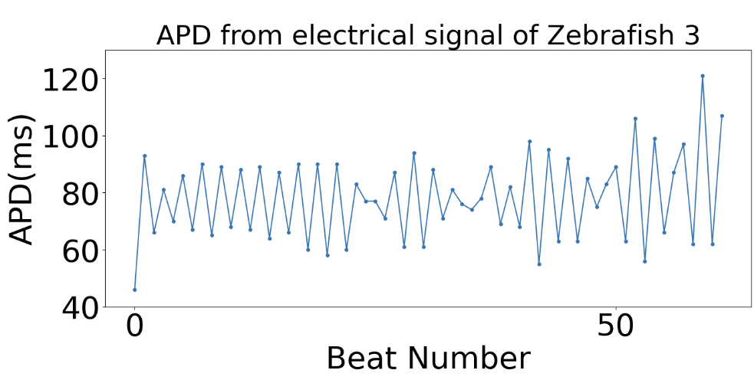
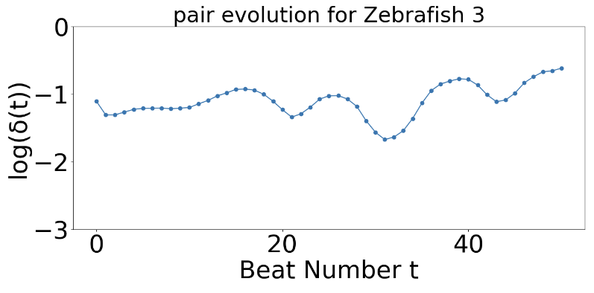
Quantify fibrillation: Temporal Method
Now, let’s see what we get for Zebrafish heart experiments:
Experiments 3 and 4
Experiment 3
Lyp exp: 0.11
Experiment 4
Lyp exp: 0.02

Slide 14
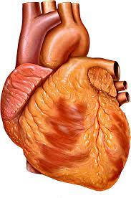
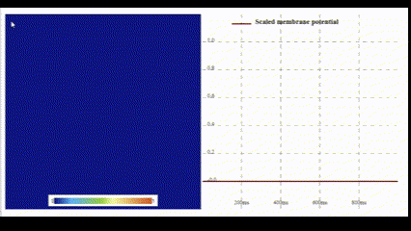
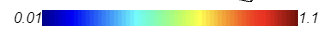
Spatiotemporal Temporal Method for Lyapunov Exponent:
We can calculate temporal and spatiotemporal Lyapunov Exponents from simulations and experiments in tissue.
We take advantage of fast GPU simulations using webGL.
https://abubujs.org/ (Dr. Abouzar Kaboudian)
It can run real-time simulation on PC, tablet and even cell phone.
Wave propagating
(simulation)

Slide 15
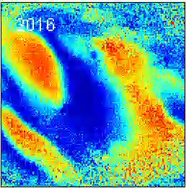
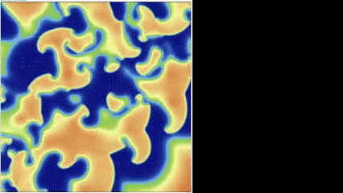
Spatiotemporal Temporal Method for Lyapunov Exponent:
We can calculate temporal and spatiotemporal Lyapunov Exponents from simulations and experiments in tissue.
We use a 3V-SIM ionic model for simulations.
Optical mapping experiments from rabbit and pig hearts.

Slide 16
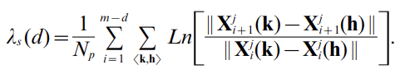
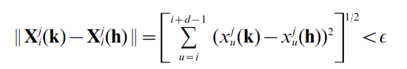
Spatiotemporal Temporal Method for Lyapunov Exponent:
A spatiotemporal LE is defined:
s means spatial
k = every point of 2D map from t_i to t_(i+d)
h = neighboring points of k from t_i to t_(i+d) (neighbor distance < a small value)
d = embedded dimension
N_p = number of <k, h> pairs (take average)
j = type of X variable
i = time step
Solé, R. V., & Bascompte, J. (1995). Measuring chaos from spatial information.
Journal of Theoretical Biology, 175(2), 139–147. https://doi.org/10.1006/jtbi.1995.0126

Slide 17
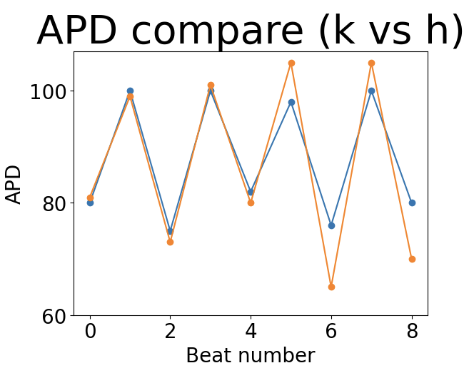

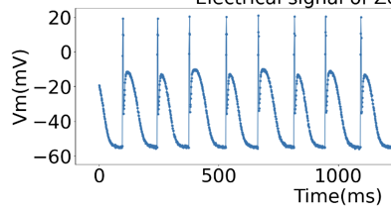



Spatiotemporal Temporal Method for Lyapunov Exponent:
We first calculate APD sequence for n points (depending on how many we want)
Then we find any points that have similar APD at same Beat Number.
Voltage for k
k
Voltage for h
h

Slide 18
Spatiotemporal Temporal Method for Lyapunov Exponent:
Then it iterates through all possible spatial pairs in map.
And evolve all the pairs, to see how they diverge.
Finally, after spatially and temporally averaged, we get spatial Lyapunov exponent
k
h’
k’
h

Slide 19

Method – Temporal and Spatial
Both temporal and spatial methods can be used to calculate LE
We can use temporal method when we have temporal information
We can use spatial method when we have both spatial and temporal information.
Let’s see how they work in simulation and experiment.
Simulation: Temporal and Spatial
Experiment 1: Temporal
Experiment 2: Spatial

Slide 20


Simulation – 3V SIM model
3V: three variables (u: membrane voltage, v: fast ionic gate and w: slow ionic gate)
It is a model that retains the minimal ionic complexity
Ifi , Isi and Iso correspond to the fast and slow inward, and slow outward (or to be simplified, Na, Ca, and K) currents

Slide 21






Simulation – 3V SIM model
By proper modification of parameters, we have three simulation with different chaotic degree.
Tau_d = 0.4
Tau_d = 0.41
Tau_d = 0.42

Slide 22




Simulation – 3V SIM model
Temporal LE ~ 0.14
Spatial LE ~ 0.63
Temporal LE ~ 0.11
Spatial LE ~ 0.4
Temporal LE ~ -0.02
Spatial LE ~ -0.01

Slide 23






Simulation
Real-time simulation demonstration

Slide 24


Quantify fibrillation of heart – Experiment 2
Optical Mapping setup

Slide 25




Quantify fibrillation of heart – Spatial Method (Result)
How we handle the data.
We first do noise elimination (temporal and spatial)
Then mask out noise
Then we drift voltage to same bottom
We plot the bottom line as the APD threshold (red line) and obtain APD based on that

Slide 26




Quantify fibrillation of heart – Spatial Method (Result)
Chaotic fibrillation in pig heart captured by two cameras
Less chaotic fibrillation
Healthy heart (Periodic)
endocardium
epicardium

Slide 27

More result from optical mapping (cam 1)
Chaotic, endocardium
Chaotic, epicardium
Less chaotic
Periodic

Slide 28
Conclusions
We have shown that it is possible to quantify the fibrillation of heart by calculating Lyapunov exponent of APD with spatial and temporal methods.
Since the WebGL makes simulation computationally cheap, we could do fibrillation analysis quantitatively on different parameter sets and related studies on drug effect with even more complicated model.
Besides simulation, the methods mentioned here works well in experiment to distinguish chaotic and non-chaotic patterns.
Future studies on hyperparameters (embedded dimension, neighboring distance) in those methods with their effect on Lyapunov exponent calculation in cardiac system could be done.
We have also shown that different camera in optical mapping experiment won’t change the spatial or temporal Lyapunov exponent of system dramatically.

